Slide 1
Sprint 3 Final Report
Spatial Diamond Grid
Edge-AI Campus Monitor
Final Integration and Triangulation Optimization
SCRUM Roles
Product Owner: Msibi Sandziso
Scrum Master: Mariane Lara
Developer: Dlamini Thabani
Sprint Window: May 13 - May 28

Slide 2
Sprint Overview
Goals and scope of Sprint 3
GOAL 1
GOAL 2
GOAL 3
Fix false positives
Deploy 8-sensor array
Align ML schema
Correct the directional alert bug discovered in Sprint 2 so inactive zones report NONE instead of a false source.
Separate PM2.5 and CO inputs across four cardinal zones using an independent hardware layout.
Rebuild input handling so the firmware data structure matches the training dataset columns directly.
SCOPE OF WORK
Hardware overhaul
Isolate PM2.5 and CO for North, West, East, and South nodes.
Feature mapping
Bind physical pin arrays directly to the 4-feature ML runtime layout.
Baseline spike filter
Introduce a threshold gate to prevent clean-air leakage into alert logic.

Slide 3
Product Backlog
Updated sprint backlog status
ID | Feature | Priority | Status
1 | Data Collection Module | High | Completed in Sprint 1
2 | Spatial Averaging Framework | Medium | Dropped by Product Owner
3 | Independent Multi-Node Engine | High | Completed in Sprint 2
4 | Decoupled Air Pollutant Features | High | Completed in Sprint 3
5 | Directional Source Tracer Compass | High | Completed in Sprint 3
6 | Visual Telemetry Dashboard | Medium | Completed in Sprint 3

Slide 4
Task Allocation
Sprint planning execution
DEVELOPER A
DEVELOPER B
DEVELOPER C
Hardware circuit duplication
Calibration and filtering
Pipeline reconstruction
Added independent rotary dials for each cardinal node so each zone captures separate PM2.5 and CO values.
Built the SPIKE_THRESHOLD = 400 baseline filter to remove the faulty zero-value directional alert condition.
Mapped eight raw extractions to the normalized four-feature array consumed by the embedded ML engine.
Status: Completed
Status: Completed
Status: Completed

Slide 5
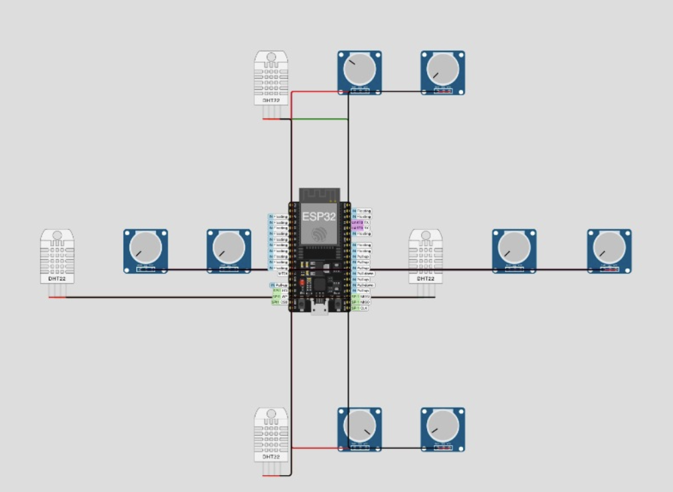
System Architecture
Final integrated architecture
Physical layer: Four cardinal nodes arranged in a spatial diamond topology.
Per-node hardware: 1 DHT22 plus 2 isolated analog gas emulators.
Preprocessing: 12-bit ADC input mapped from 0-4095 and normalized for tensor compatibility.
ML core: EloquentTinyML inference with a 4 KB memory arena to avoid ESP32 freezes.
pm2.5
co

Slide 6
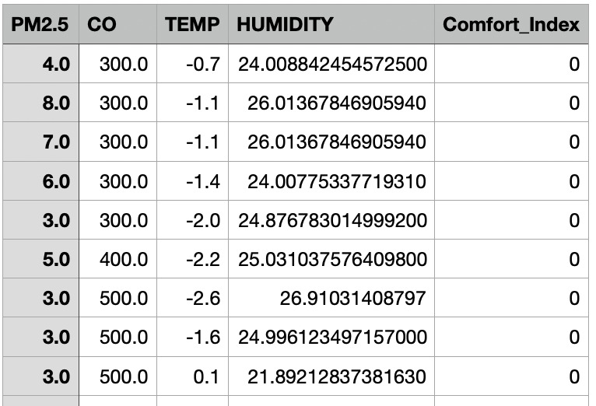
Dataset Alignment
Reconstructed feature mapping
Sprint 2 combined pollutant traces in a way that reduced feature resolution. Sprint 3 corrected this by mapping each physical value directly to the machine learning schema.
Column 0: PM2.5
Column 1: CO
Column 2: Temperature
Column 3: Humidity
Result: no duplicated channels, no merged pollutant streams, and one-to-one schema alignment.

Slide 7
GPIO Mapping
Physical pin mapping matrix
Zone Direction | DHT22 Pin | PM2.5 Pin | CO Pin
North Node | GPIO 15 | GPIO 34 | GPIO 35
West Node | GPIO 16 | GPIO 32 | GPIO 33
East Node | GPIO 17 | GPIO 25 | GPIO 26
South Node | GPIO 13 | GPIO 27 | GPIO 14
All analog pollutant inputs were routed through stable ADC-compatible lines to support isolated sensing and runtime stability.

Slide 8
Embedded ML
Inference logic on the ESP32
MODEL ENGINE
DECISION RULE
TensorFlow Lite for Microcontrollers via EloquentTinyML
If Score > 0.8 → STATUS: POOR
If Score ≤ 0.8 → STATUS: GOOD
Input vector: scaledPM25, scaledCO, scaledTemp, scaledHumidity
Safety overrides also trigger if temperature falls outside 15.0°C to 33.0°C or raw pollutant values exceed 2200.
Output: 1 confidence score from 0.0000 to 1.0000

Slide 9
Directional Tracer
Source compass algorithm
STEP 1
STEP 2
STEP 3
STEP 4
Initialize baseline
Scan all nodes
Lock highest spike
Return stable output
Set maxPM25Val = 400 and maxCOVal = 400 as the clean-air cutoff.
Compare pollutant values across North, West, East, and South channels.
Capture the index of the strongest valid PM2.5 or CO source direction.
Report NONE if no channel crosses the threshold and avoid false alarms.

Slide 10
Challenges Solved
Key technical issues resolved
CHALLENGE 1
CHALLENGE 2
Clean-air false-positive bug
ESP32 pin resource collisions
Issue: Index values initialized at -1 caused the system to falsely accuse a node even when all sensors read zero.
Issue: Expanding to eight analog pollutant sliders risked unstable ADC behavior and peripheral conflicts.
Solution: Introduced SPIKE_THRESHOLD = 400 so inactive zones now correctly return NONE.
Solution: Routed inputs to stable pins 34, 35, 32, 33, 25, 26, 27, and 14 for safer execution.

Slide 11
Review and Deliverables
Completed Sprint 3 outputs
Independent 8-sensor diamond hardware array.
Separated PM2.5 and CO feature channels for each node.
Directional tracer that correctly returns NONE for inactive zones.
Readable rolling telemetry log output for live validation.
Stakeholder verification
All four zones were tested independently. Changing one parameter updated only the corresponding sensor row, confirming full isolation and correct calibration.
4
8
Zones tested
Pollutant channels

Slide 12
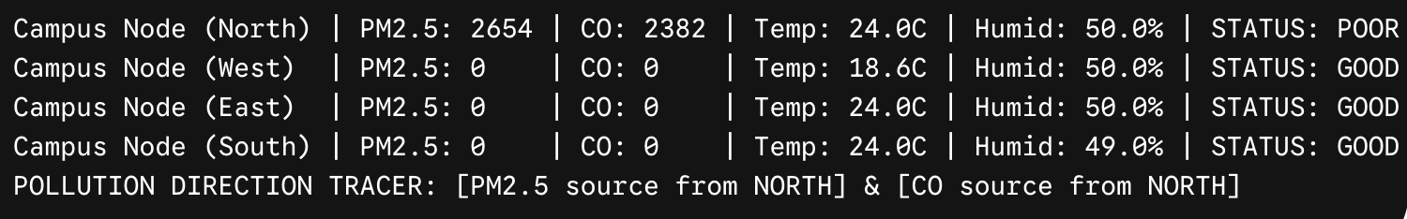
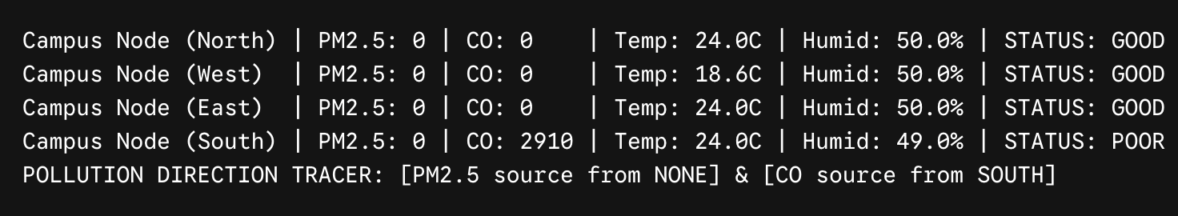
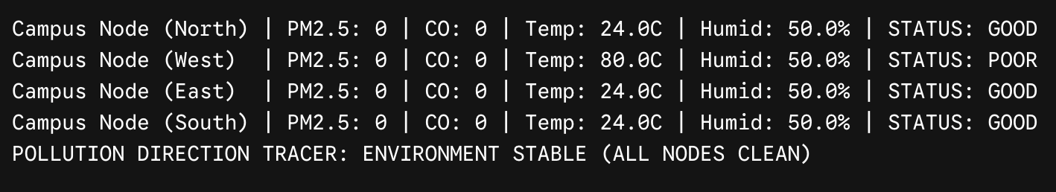
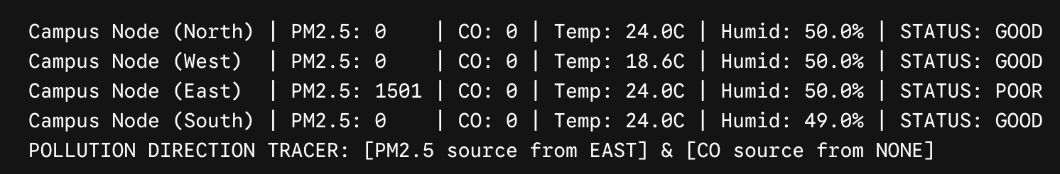
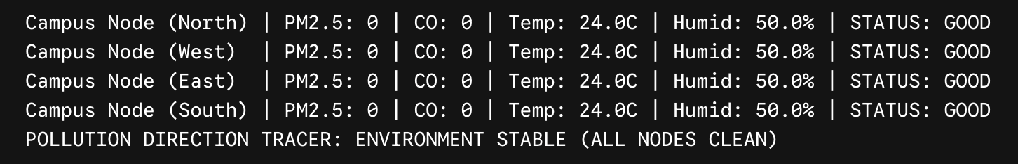
Retrospective
Lessons learned and live output
What went well
Input telemetry was restructured to match the target dataset columns exactly.
False directional tracking was corrected with a math-based baseline filter.
Hardware topology now mirrors software array indexing clearly.
What we learned
Dataset-driven hardware design reduces later formatting and mapping issues.
Edge AI systems need defensive filtering to prevent unstable small-signal alerts.

Slide 13
Q&A
Thank You

